Slide 1
SunTrac Braze-Welding Jig
5 April, 2020 - Northern Arizona University
Kadeja Alhossaini
Nathan Firor
Edwin Smith
Ethan Vieane

Slide 2
Project Introduction: Client
Suntrac USA is a hybrid climate systems company
Based in Tempe, AZ
Manufacture a solar energy heat exchanger to be used in AC and HVAC systems
Save 40% on cooling energy costs with a panel hooked up to an HVAC unit
Projected to grow company to meet increase in product demand
Require new practices to increase production efficiency
Decrease idle workspace
Vieane 1

Slide 3
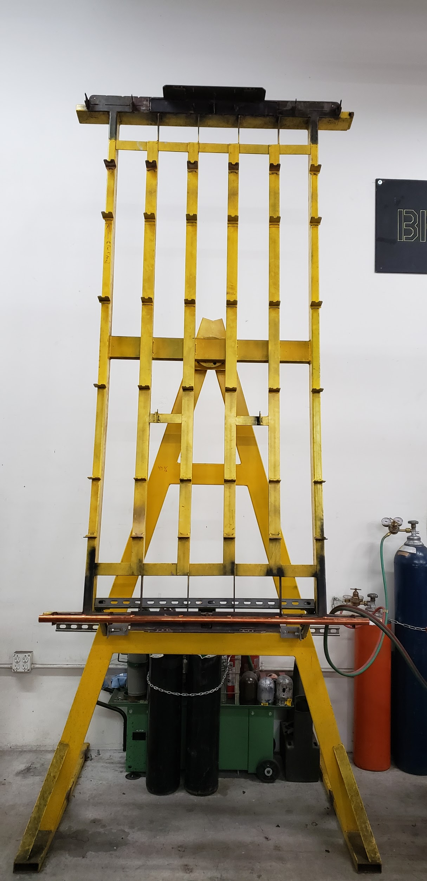
Project Introduction: Task
Design, Build, and Test a braze welding jig that is compatible with SunTrac’s 4ft, 6ft, and 8ft products
Provide a completed CAD package with assembly drawings
Create part list, BOM, and final cost estimate
Build a full scale prototype
Test prototype for engineering requirements
Create an Operation and Assembly Manual
Figure 2: Current 8 Foot Manifold Jig
Vieane 2

Slide 4
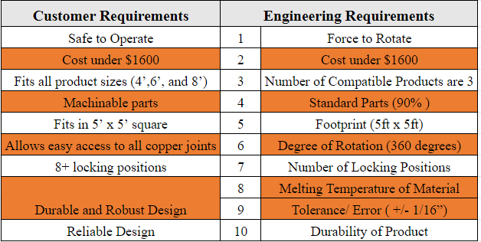
Requirements and Specifications
The Customer Requirements (CRs) were developed after speaking with the client at SunTrac. Each customer requirement has at least one Engineering Requirement (ER) set to it.
Table 1: Customer Requirements & Engineering Requirements
Vieane 3

Slide 5
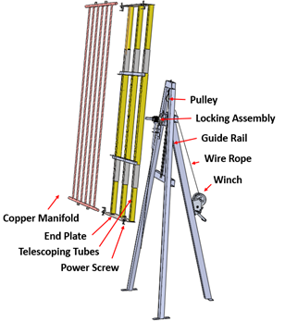
Conceptual Design
Sub-Assembly
Jig Face
Telescoping Tubes
Power Screw
End Plate
Jig Frame
Locking Assembly
Guide Rail
Wire Rope
Pulley
Winch
Figure 3: Final Prototype
Smith 4

Slide 6
Manufacturing Design: Details
Visit the client’s manufacturing facility for 3 consecutive weekends
Week 1: Jig face 2x2’s and Jig Frame 2x4’s cut to size, pin holes drilled
Week 2: Bolt and weld all subassembly connections for a finalized Jig Frame
Week 3: Attach end plates to telescoping tubes, weld Jig Face to Frame
Convene as a group on design revisions
Involve client in final consensus on debatable revisions
Smith 5

Slide 7
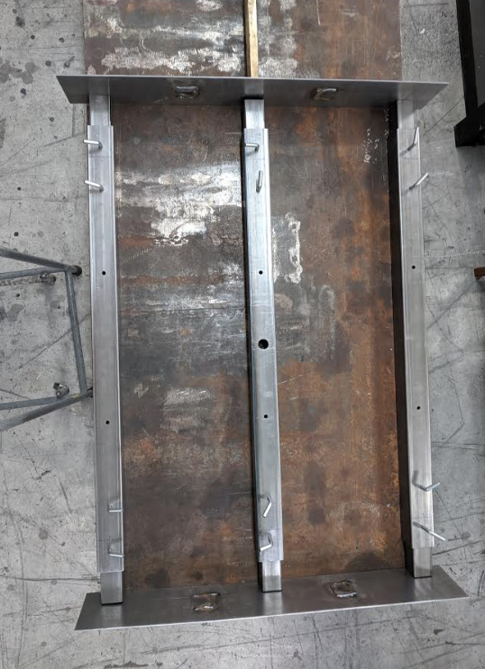
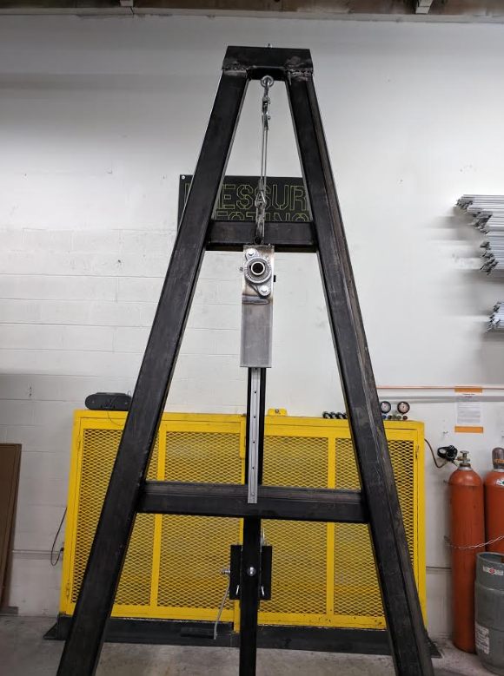
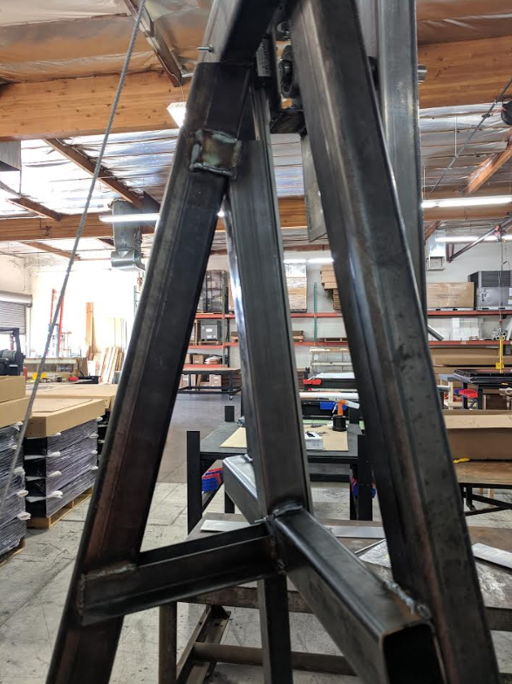
Manufacturing Design: Documentation
Figure 4: Jig Face
(4 Foot Configuration)
Figure 5: Front View of Jig Frame
Figure 6: Side View of Jig Frame
Smith 6

Slide 8
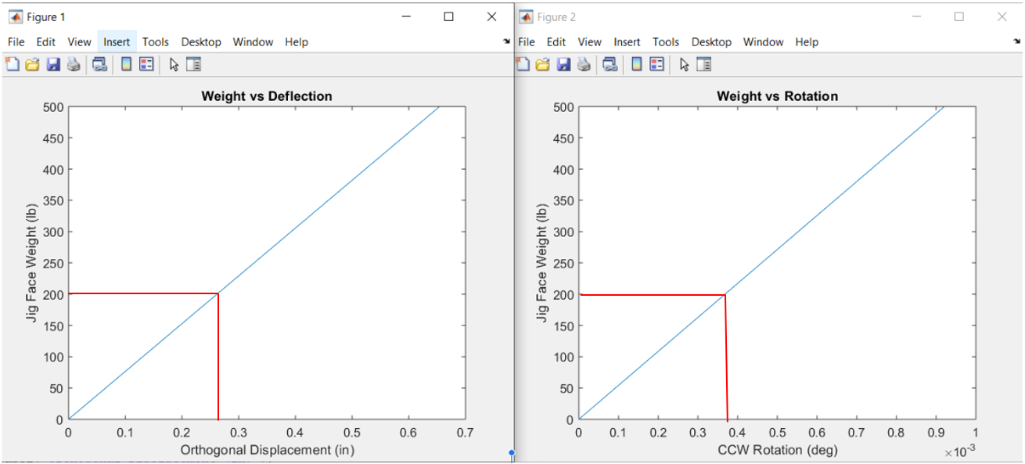
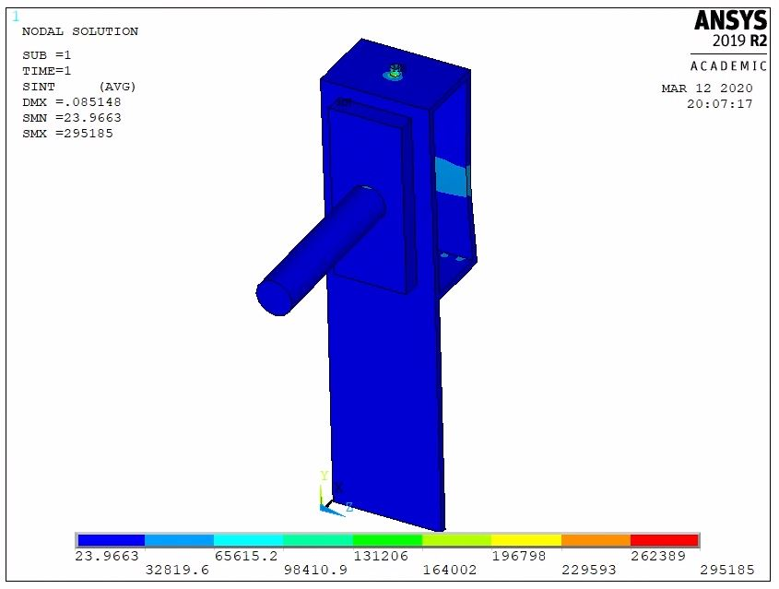
Manufacturing Design: Computational Analyses
Guide Rail Structural Analysis
Expected center deflection of 0.26’'
Negligible rotation
Justifies adding an extra support
Figure 7: Guide Rail Structural Analysis
Locking Assembly FEA Analysis
Stress concentration at back side carriage connection
High eye bolt stresses for tear-out
Factor of safety of 2
No support needed
Figure 8: Locking Assembly FEA Analysis
Smith 7

Slide 9
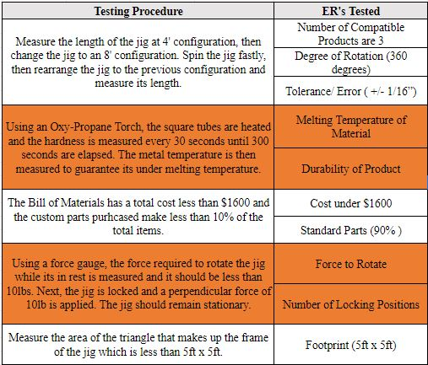
Testing
Table 2: Testing Procedures & Engineering Requirements
The testing procedures implemented were set to satisfy each Engineering Requirement.
Most of the tests were designed to validate multiple ER’s
Predetermined Design Validation
Manufacturing Contingencies
Complete Prototype Testing
Firor 8

Slide 10
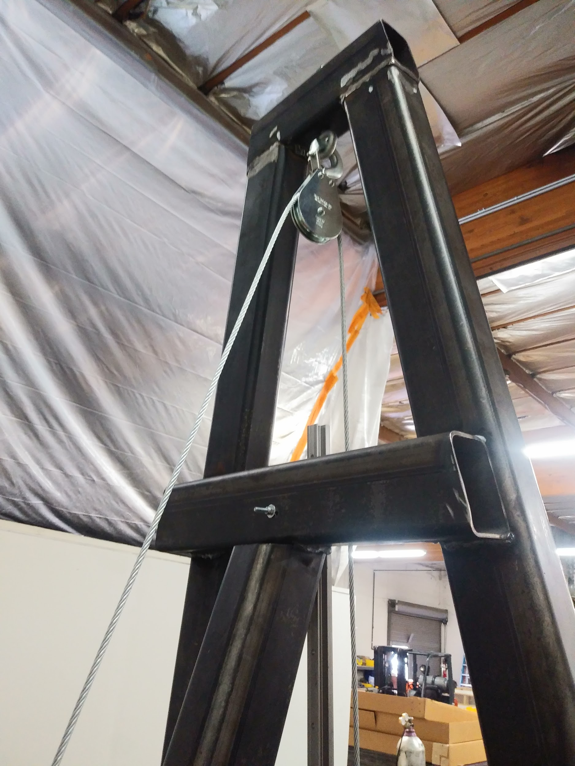
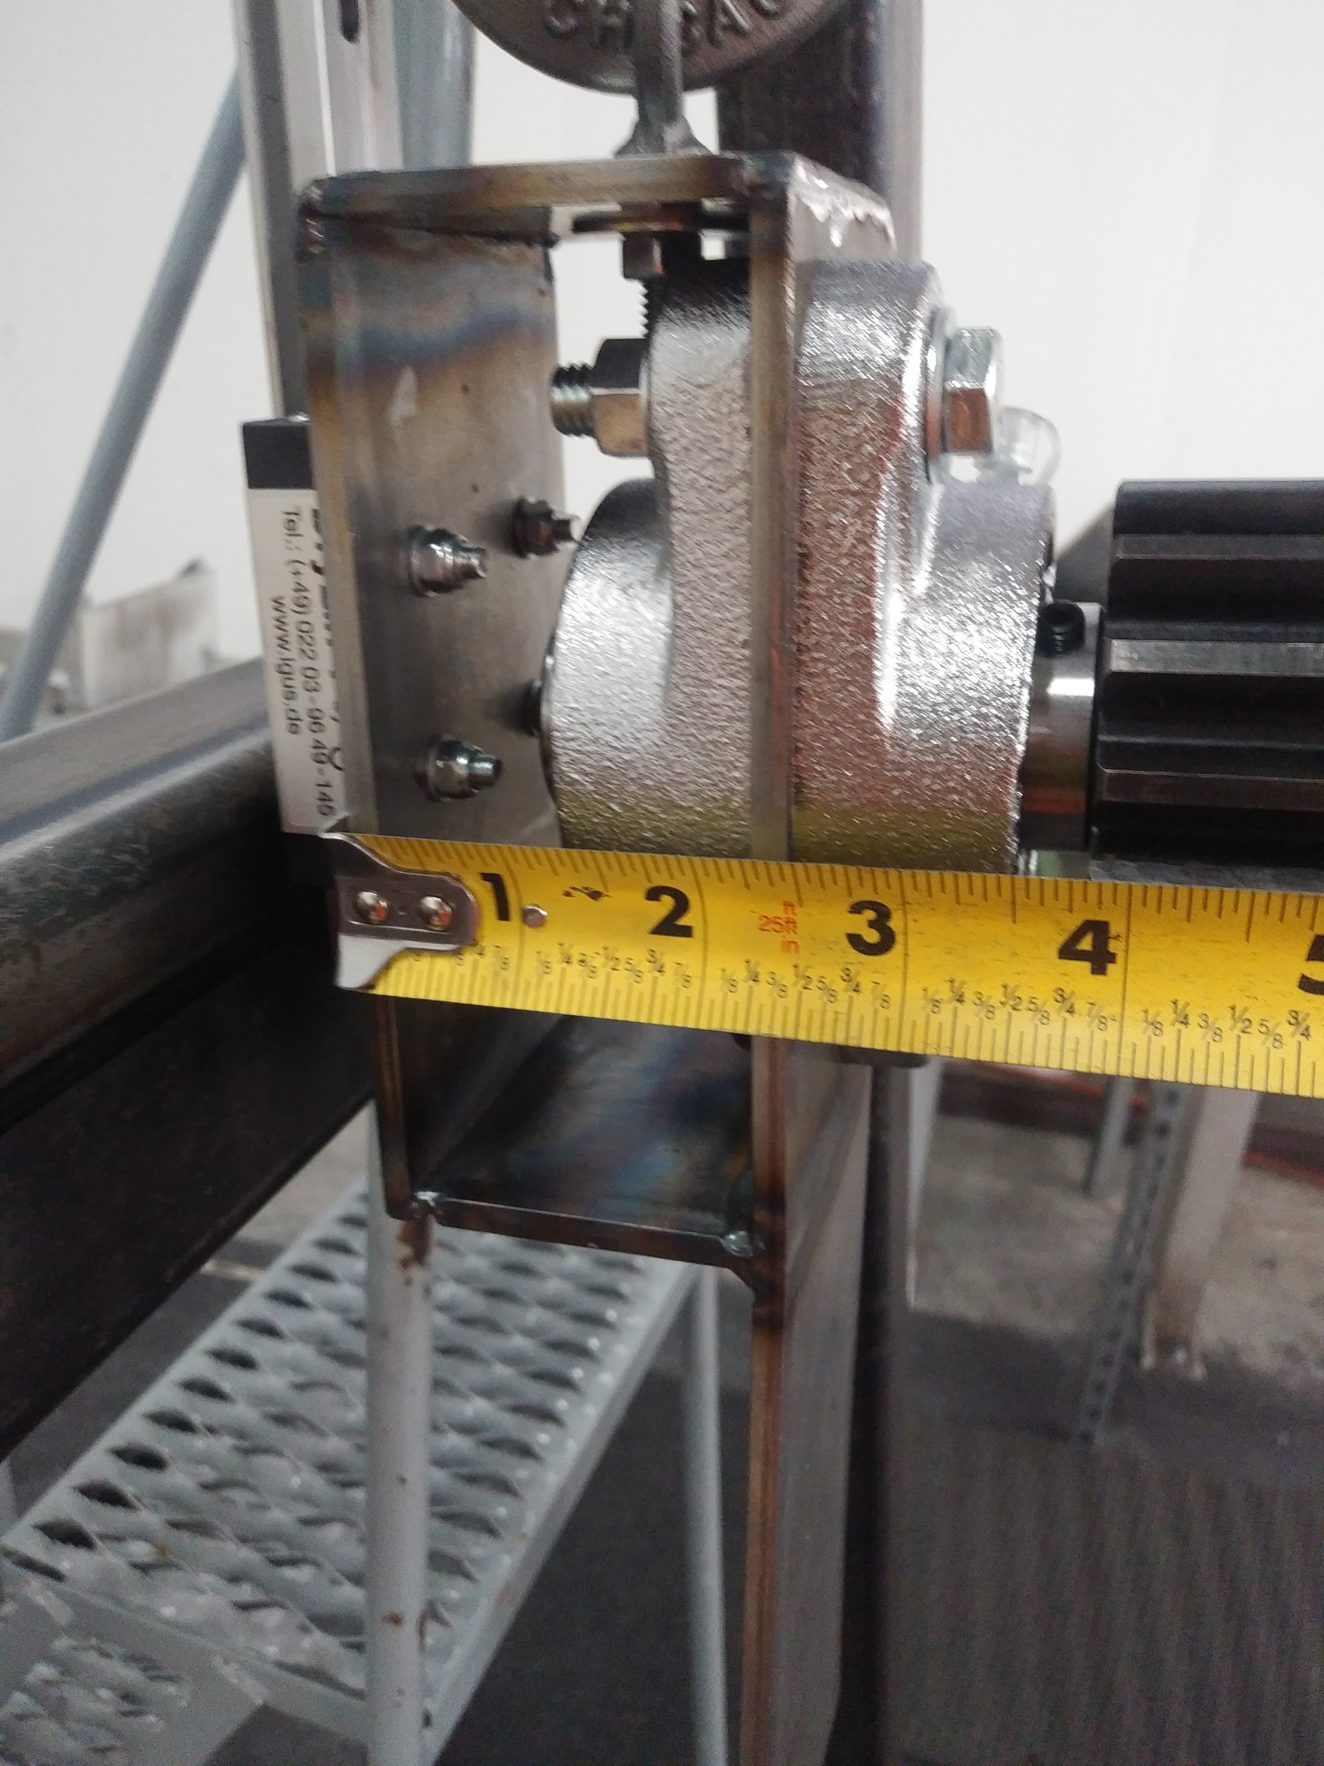
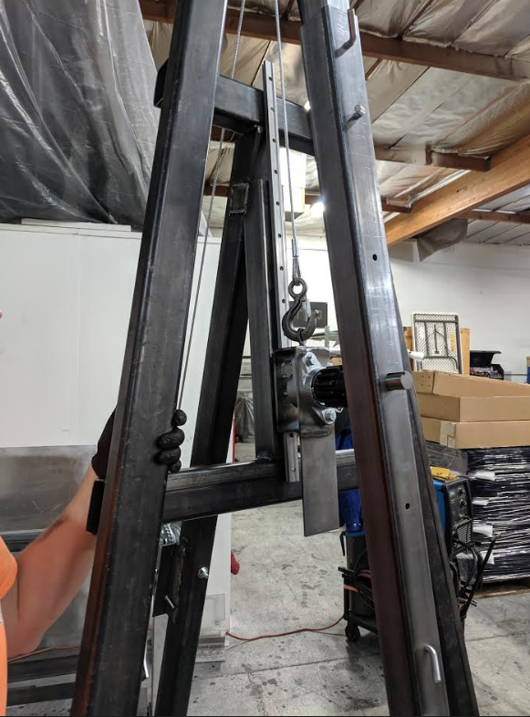
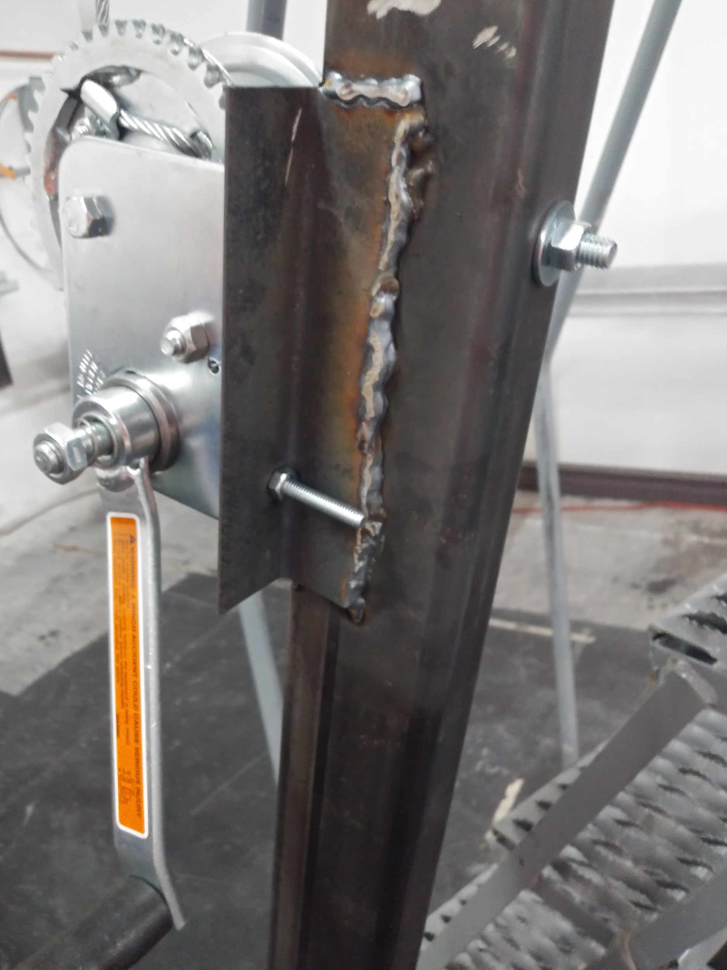
Final Product: Gallery
Figure 10: Back View of Pulley
Figure 12 : Locking Mechanism Close Up
Figure 9: Winch and Mount Augment
Figure 11: Jig Frame With Winch and Locking Mechanism
Firor 9

Slide 11
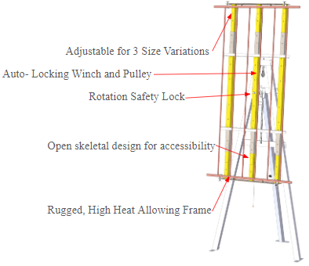
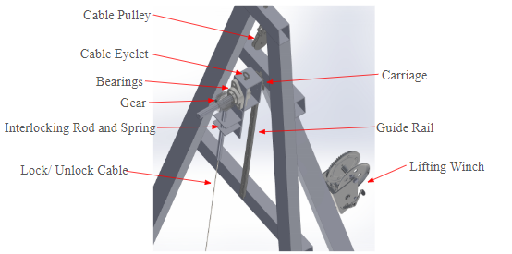
Final Product: CAD Comparison
The prototype was built with the all of the mechanical components utilized in the CAD model and detailed in the BOM.
Figure 13: CAD of Mechanical Components
Figure 14: CAD Reflected Jig Features
Firor 10

Slide 12
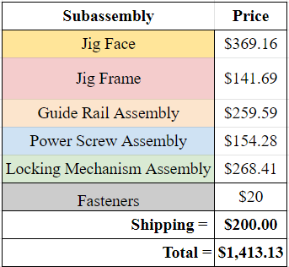
Budget
The budget for this project is $1600.00 as set by SunTrac
Total Price at $1413.13
Subassembly prices are listed in the right column of figure 15
Full Bill of Materials (BOM) found in Appendix A.1
Figure 15: Sub-Assembly Price Breakdown
Alhossaini 11

Slide 13
Future Work
Final Welds to Combine Sub-assemblies
Operation & Assembly Manual
Final Tests on the Device
Final Report
Final Website
SunTrac wants to suspend visits till further notice due to COVID-19 outbreak.
To ensure the manufacturing and assembly process is followed.
To account for all the changes on the design to achieve the final product.
SunTrac invited the team back to finish tests over Summer 2020
To document the teams progress and final product.
1
2
3
4
5
Alhossaini 12

Slide 14
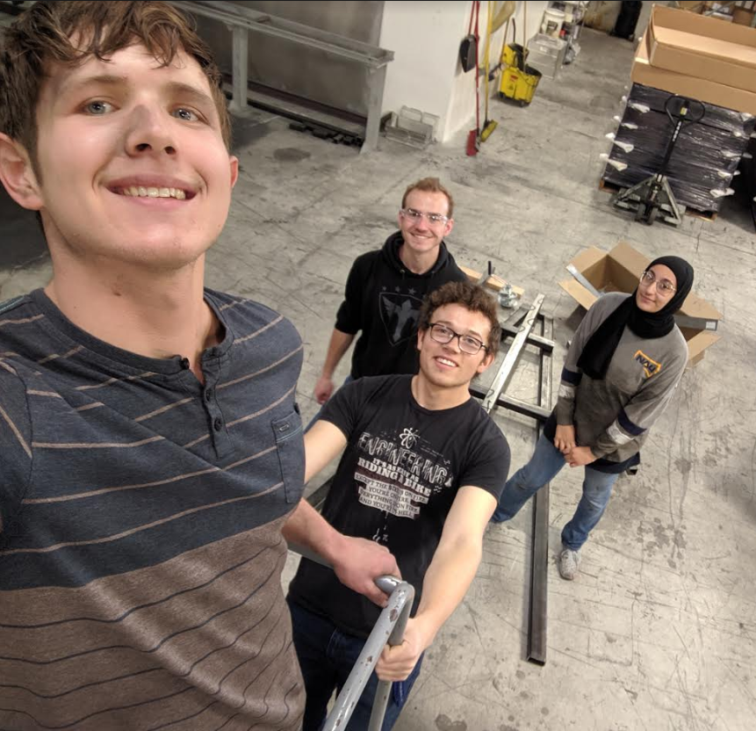
Thank You For Listening
For any questions please email the team:
Kadeja Alhossaini: ka956@nau.edu
Nathan Firor: naf76@nau.edu
Edwin Smith: ejs328@nau.edu
Ethan Vieane: esv25@nau.edu
Figure 16: Team Selfie in SunTrac
Alhossaini 13

Slide 15
References
[1] https://www.suntracusa.com/gallery

Slide 16
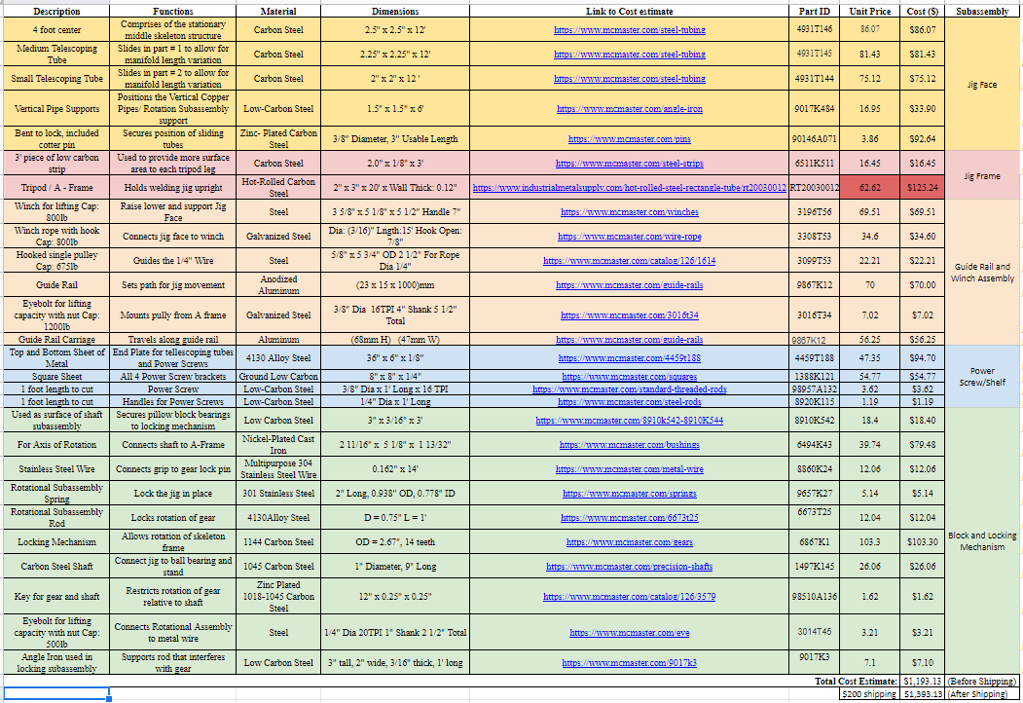
Appendix A.1 - Bill Of Materials
Table 3: Bill of Materials

